Slide 1
WorkshopPLUS – Power Apps for Power Users 1 Day with Lab Module 1: Introduction

Slide 2
Disclaimer

Slide 4
Overview of Power Apps
Dataverse for Teams
Administration Overview
Fundamentals

Slide 5
Power Apps Overview

Slide 6
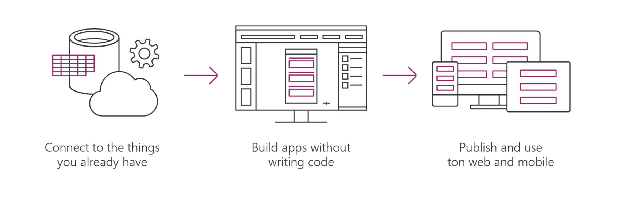
Microsoft Power Apps helps business power-users to create and use custom business apps across platforms.
Connect to data & systems you’re already using; Create the data you need.
Create apps, forms, and workflows without writing code.
Use apps on web and mobile.
Notes:
MSFT PowerApps is a SaaS service for creating and using custom customer business apps across different mobile and web platforms
It connect to excising enterprise systems and data sources you already have allows you to build LOB apps that utilizing the investment you’ve already made in your existing enterprise systems, without have to duplicate data and thus keeping a ‘clean’ single version ‘of the truth’
PowerApps enables you to build Apps without have to write code. It enables you to build Apps declaratively. With PowerApps, business experts can work more efficiently together with their counterparts in IT and consulting partners, literally on the same page in a visual designer—or solve problems on their own. Through an integration with Microsoft Flow, you can trigger flows right from within apps.
The Apps can be published instantly to co-workers across web, tablets and mobile devices for easy sharing and consumption within your organization.
Power Apps is a suite of apps, services, and connectors, as well as a data platform, that provides a rapid development environment to build custom apps for your business needs. Using Power Apps, you can quickly build custom business apps that connect to your data stored either in the underlying data platform (Microsoft Dataverse) or in various online and on-premises data sources (such as SharePoint, Microsoft 365, Dynamics 365, SQL Server, and so on).
Apps built using Power Apps provide rich business logic and workflow capabilities to transform your manual business operations into digital, automated processes. What's more, apps built using Power Apps have a responsive design and can run seamlessly in browser and on mobile devices (phone or tablet). Power Apps "democratizes" the business-app-building experience by enabling users to create feature-rich, custom business apps without writing code.
Power Apps also provides an extensible platform that lets pro developers programmatically interact with data and metadata, apply business logic, create custom connectors, and integrate with external data.

Slide 7
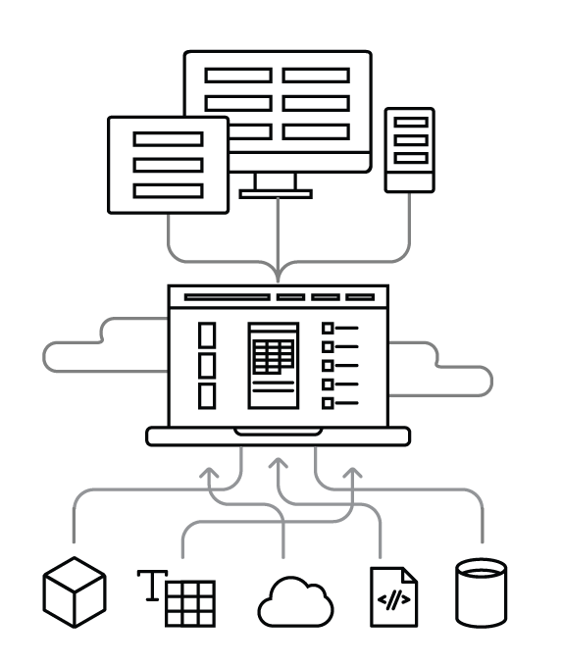
How it works
Use on web and mobile Find and use apps instantly on the web and in Power Apps mobile for iOS and Android.
Power Apps Cloud Publish apps to people in your organization so they can access anywhere.
Create in Power Apps Studio Build apps in a visual experience that shows exactly what you’ll get.
Connections Build apps that interact with your data sources and respect their permissions.
Your data Power Apps connects to a range of data sources and systems, including custom APIs.

Slide 8
Dataverse for Teams

Slide 9
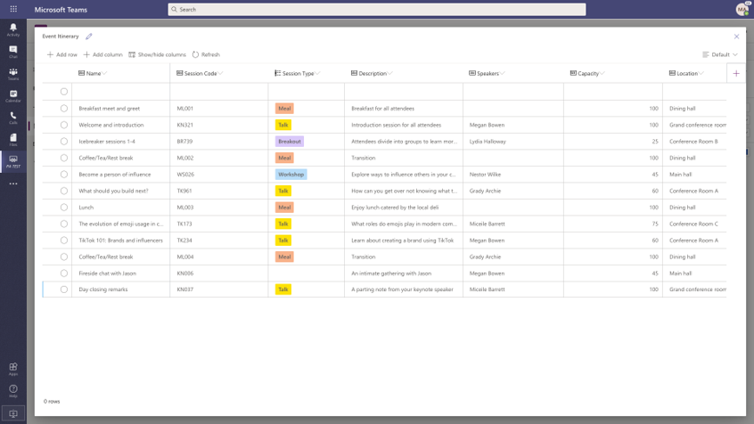
What is it?
Low-code platform
Relational storage, and rich types
Enterprise-grade governance
One-click solution deployment
Notes:
Discuss
Dataverse for Teams delivers built-in:
Low-code data platform for Microsoft Teams
Relational data storage, and rich data types
Relational
File + Image
Find, Filter, Sort
Basic Datatypes
Common Data Model (Coming Soon)
Enterprise-grade governance
Uses Environments (Capacity limits)
Uses Security (Roles)
Capacity enforcement (80% warning, 100% No new apps)
Promote environment to CDS
One-click solution deployment (https://docs.microsoft.com/en-us/powerapps/teams/use-sample-apps-from-teams-store)
Employee ideas Manager and employee apps for campaigns and ideas.
Inspection Manager and user apps for area inspections.
Issue reportingManager and user apps for issue reporting.

Slide 10
When should I use it?
Low-code and no-code within Teams.
Core data capabilities
Storage and rich data types
New visual editor
Enterprise security
Teams licenses.
Promotion to Dataverse (CDS).
2 GB per team, and support for up to 1 million rows
.
.
Notes:
Discuss
Support to build low-code and no-code apps, flows, and chatbots for and within Teams.
Core data capabilities from the same platform behind Microsoft Power Platform and Dynamics 365.
Storage, rich data types with enterprise capabilities, and one-click solution deployment.
A new visual editor that makes it even easier to define and populate table data.
Enterprise security that's easy to use and aligned with the approach used in Teams.
Inclusion in most existing Teams licenses.
Storage of 2 GB per team, and support for up to 1 million rows.
Support for up to 500 teams. Support for 5 teams plus 1 additional team for every 20 licensed users.
The capability to be promoted to Dataverse.
Mention
Supports Teams Azure AD security group with runtime (JIT) user access and privilege checks.
Auto assignment of System Administrator security role to Teams Owners.
Ability to assign different security roles to Teams Owners and Members.
No security settings management for Business Unit and Teams is required.

Slide 11
When should I not use it
Access
Coding
Data limitations
Environment limitations
Notes:
Discuss
If you require Access from outside of the Team that environment is connected to
Complicated logic or access to API is required
If you require more data then 2GB or over 1 million rows
Exceed the 500 environment limit
Mention
Other choices include
Dataverse
SP Lists

Slide 12
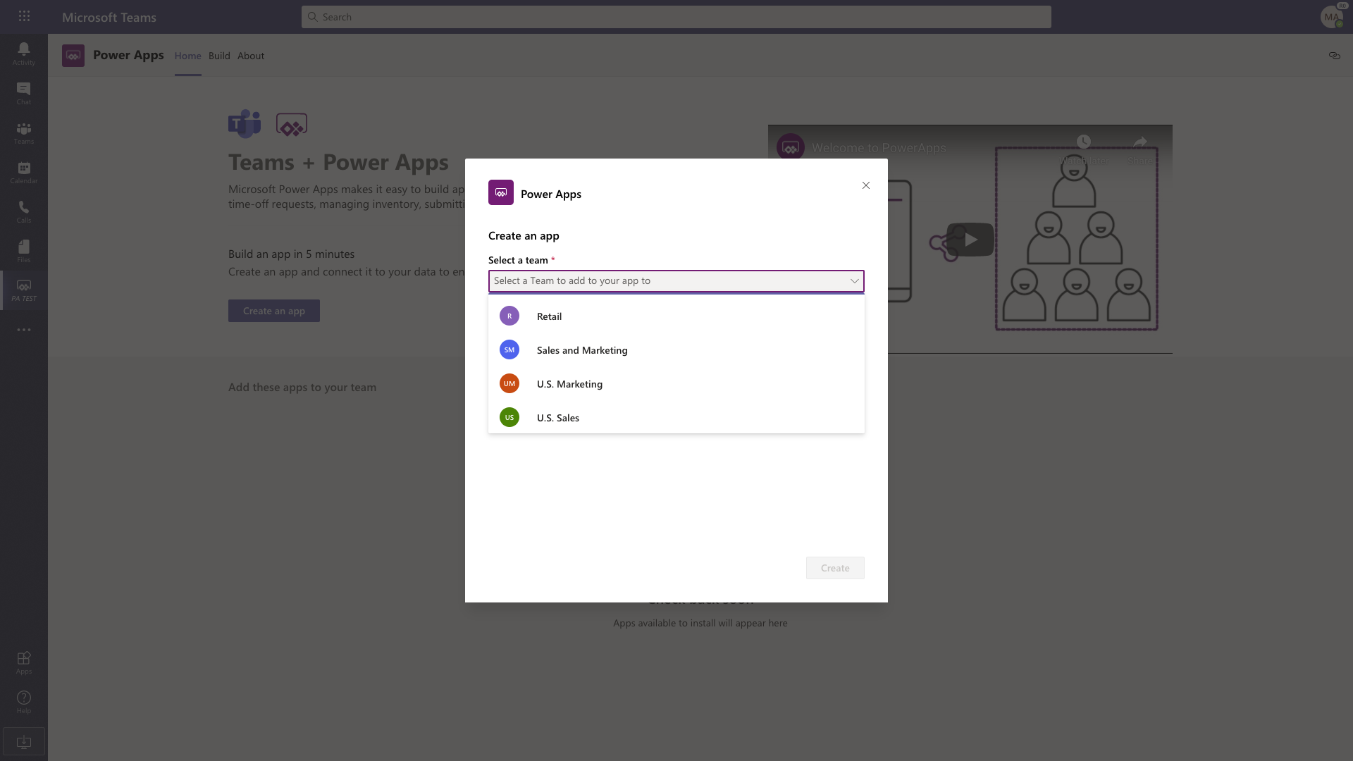
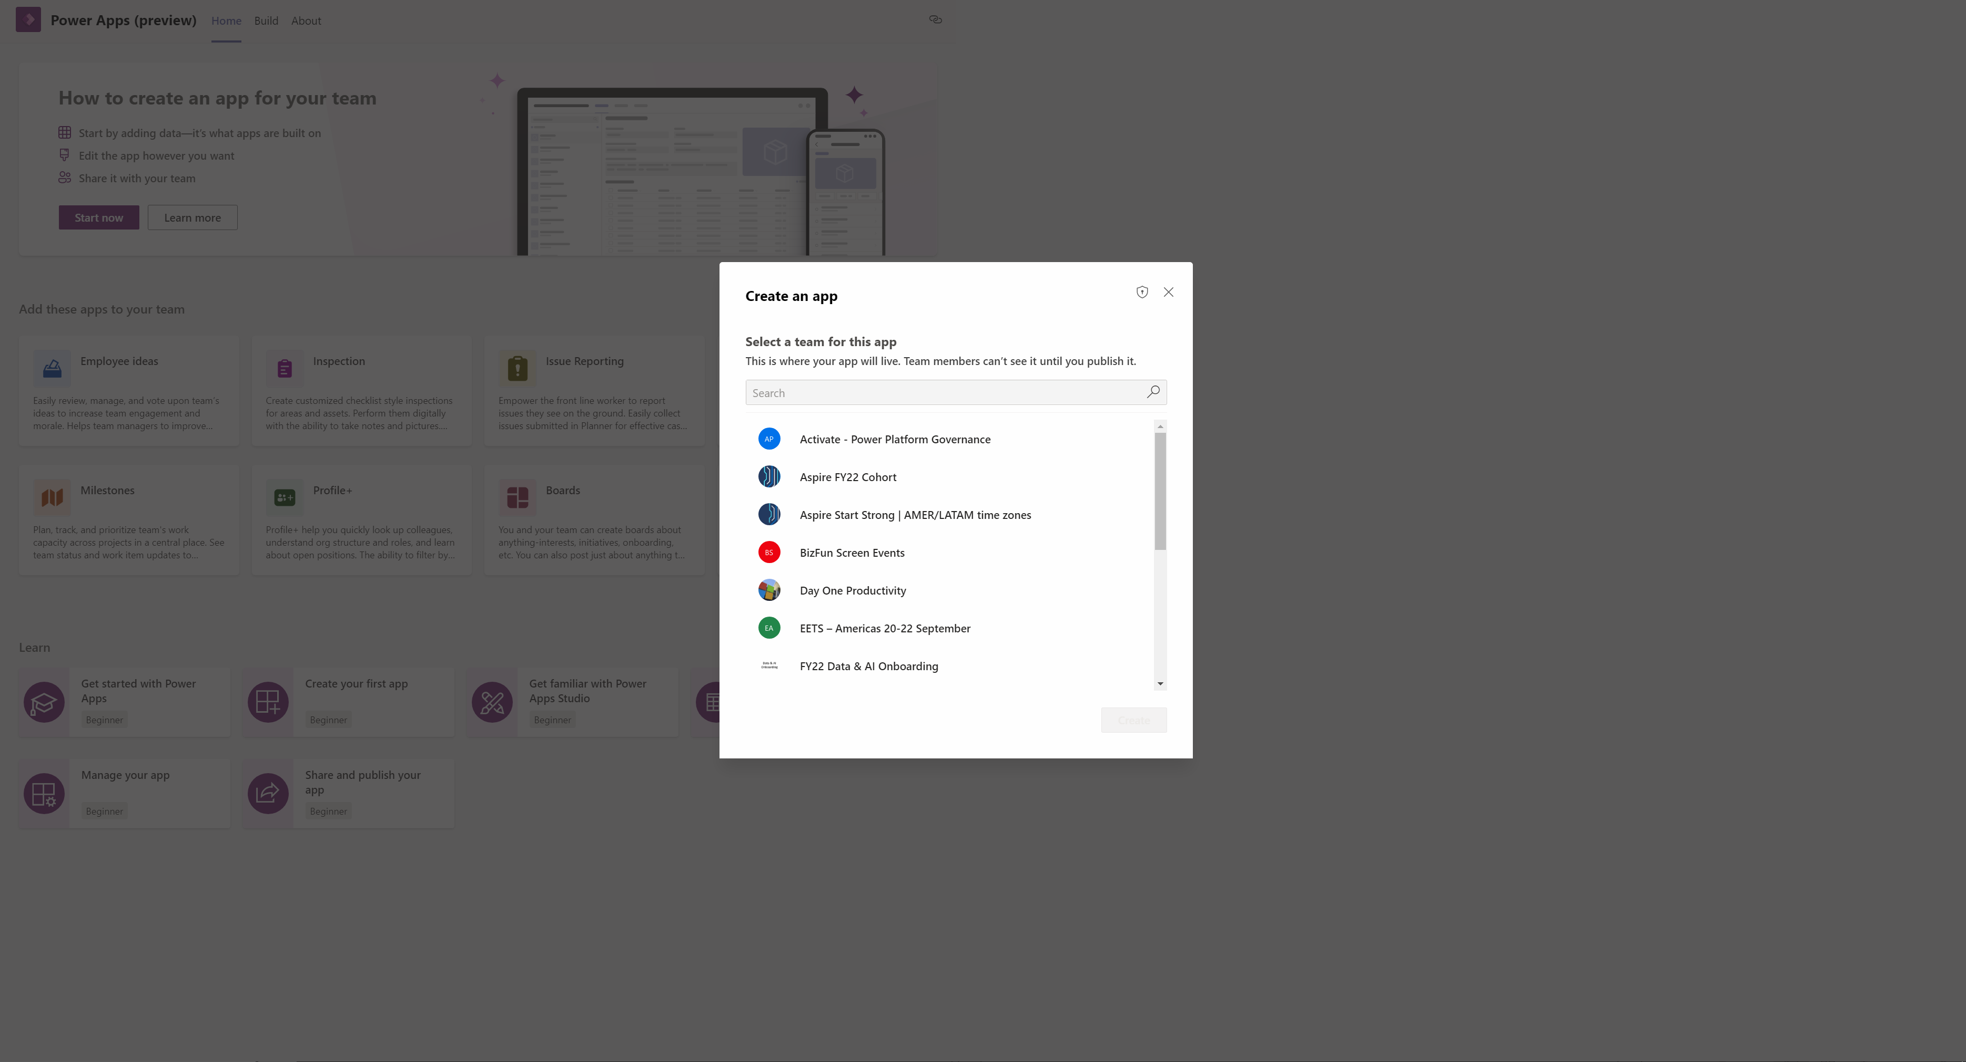
How would I use it
Environment is automatically created for the selected team when you:
1. Create a new Power Apps app in Teams for the first time
2. Install a Power Apps app from the app catalog for the first time
Notes:
Discuss
The Dataverse for Teams environment is automatically created for the selected team when you:
1. Create an app with the new Power Apps app in Teams for the first time
2. Install a Power Apps app from the app catalog for the first time.
Mention
Aligns with the core roles identified in the environment: Owners, Members, and Guests
Access to the environment is restricted just to the Teams owners, members, and guests
Granting access is managed by Teams Owner by adding or removing members
Provides support for files, images, and multiple related tables

Slide 13
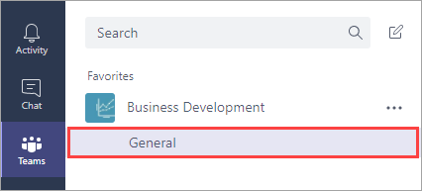
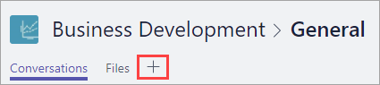
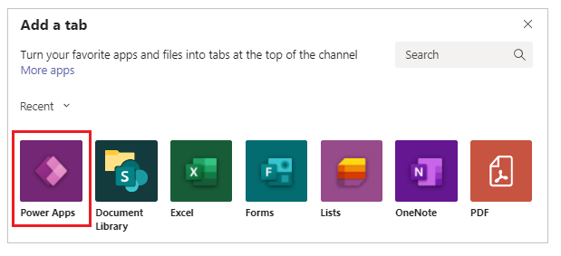
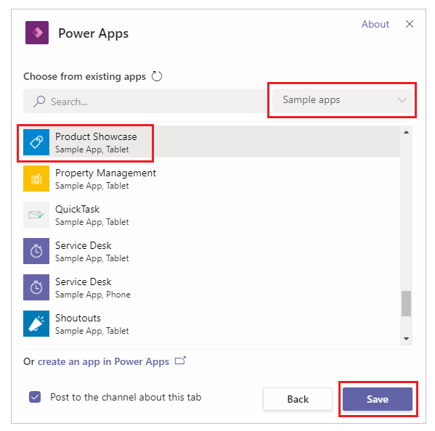
Embed a canvas app as tab app in Teams
In Microsoft Teams, select a team, and a channel under that team. In this example, it's the General channel under the Business Development team.
Choose + to add a tab.
In the Add a tab dialog box, choose Power Apps.
Choose Sample apps > Product Showcase > Save
Notes:
Embed a canvas app as tab app - Power Apps | Microsoft Docs
Embed an app in Teams - Power Apps | Microsoft Docs

Slide 14
Power Virtual Agent Overview
Notes:
Slide hidden because feature not available in DoD

Slide 15






Overview
Power Virtual Agents is a low-code / no-code, guided graphical interface solution that allows easy creation of chatbots by users of Microsoft Teams
Chatbots in Teams to help employees with common issues and answer common questions
Chatbots in Teams are transforming how organizations engage with their employees
Notes:
Slide hidden because feature not available in DoD

Slide 16




Lifecycle of a Power Virtual Agent chatbot
Create
Build
Teach
Create using a simple graphical interface
User starter topics to build upon
Author topics with variables, etc.
Improve
Configure
Monitor performance and improve
Configure topics details
Release
Extend
Publish to Microsoft Teams
Extend activities for more complex scenarios
Notes:
Slide hidden because feature not available in DoD
Have some light conversation about who they would build PVA bot

Slide 17
Learn More
Dataverse for teams Workshop
DataSheet

Slide 18
Administration Overview

Slide 19
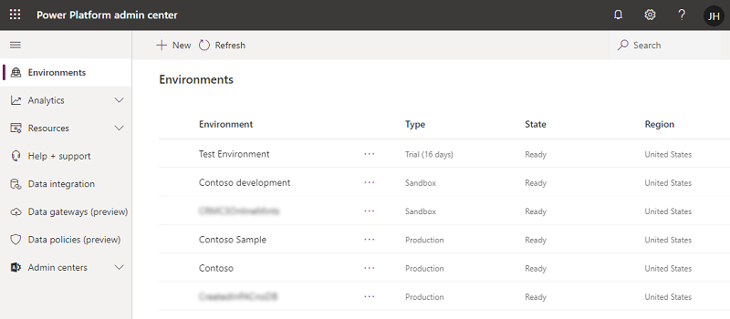
Power Platform Admin Center
Notes:
Mention:
Environment, a placeholder to divide the PowerApps
https://admin.powerplatform.microsoft.com/
Administer Power Platform - Power Platform | Microsoft Docs

Slide 20
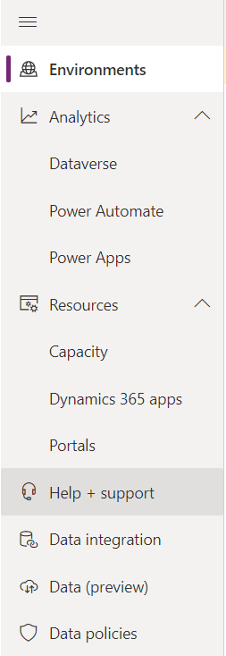
Power Platform Admin Center Capabilities
View, create, and manage environments.
View key metrics for Power Apps.
View and manage all Power Apps resources.
Submit support request.
Notes:
Discuss:
In each environment all resources (PowerApps and Flows) can be viewed and managed.
View Properties like Connections and Flows being used
Who it is share with
Owner
Create/Modify date
Mention:
For more information you can attend WorkshopPlus – PowerApps for Administrators

Slide 21
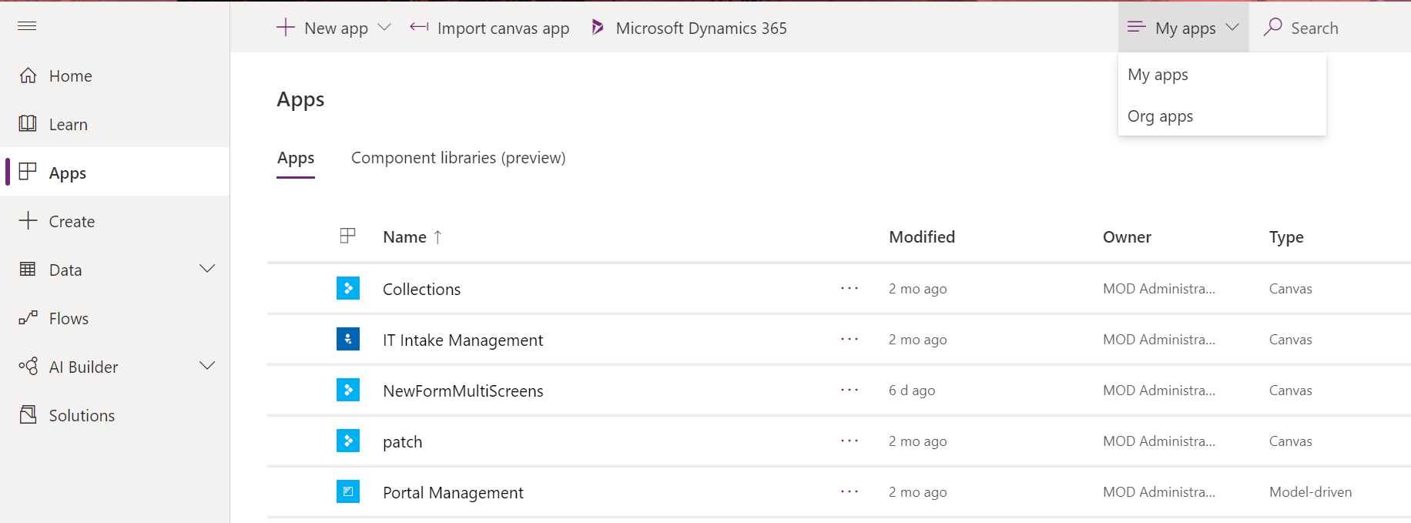
Browsing apps – Maker Portal
Notes:
Discuss:
All users can access this page at https://web.powerapps.com
View apps in web or mobile client
Filter by: Recent apps / Shared with me /App I can edit / Org apps
Mention:
Each App has settings like Edit, Play, Share, Export package, Analytics, Settings, Delete, and Details
You can Share apps from here
Set Properties like App Name, Description, etc.
View details about App like Owner and last modified date

Slide 22
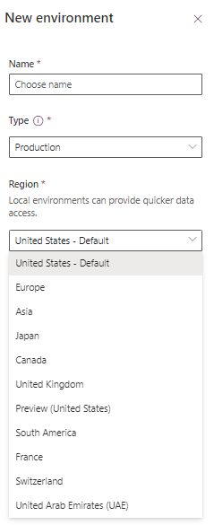
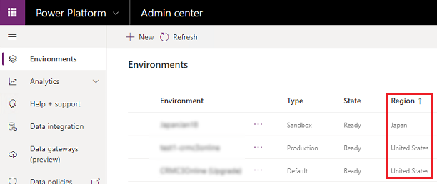
Regions in PowerApps
You can create an environment in a different region than where your tenant resides.
Local environments can provide quicker data access for users in that region.
Notes:
PowerApps environment region
Choose the region when setting up an environment - Power Platform | Microsoft Docs
Multi geo in PowerApps
In a multi-geo configuration, your Microsoft 365 tenant consists of a central location and one or more satellite locations. This is a single tenant that spans across multiple geo locations.
PowerApps created for the satellite location will use the end point located in the central location for the tenant. Microsoft PowerApps is not a Multi-Geo service.
PowerApps support creating an environment in a specific region
Here are some key multi-geo terms to help you understand the basic concepts of the configuration:
Tenant – An organization's representation in Microsoft 365 which typically has one or more domains associated with it (for example, https://contoso.sharepoint.com).
Geo locations – The geographic locations available to host data in a Microsoft 365 tenant.
Satellite locations – The additional geo locations that you have configured to host data in your Microsoft 365 tenant. Multi-geo tenants span more than one geo location, for example, North America and Europe.
Preferred Data Location (PDL) – The geo location where an individual user's Exchange and OneDrive data is stored. This can be set by the administrator to any of the geo locations that have been configured for the tenant. Note that if you change the PDL for a user who already has a OneDrive site, their OneDrive data is not moved to the new geo location automatically. See Move a OneDrive library to a different geo-location for more information. If they have an Exchange mailbox, the mailbox is moved to the new preferred data location automatically.
Plan for Microsoft 365 Multi-Geo - Microsoft 365 Enterprise | Microsoft Docs
Administering a multi-geo environment - Microsoft 365 Enterprise | Microsoft Docs

Slide 23
System requirements
Supported platforms for running canvas apps using the Power Apps mobile app
Supported browsers for running canvas apps
Minimum required | Recommended
iOS 13 or later | iOS 13 or later
Android 7 or later | Android 7 or later
Windows 8.1 or later (PC only) | Windows 10 Fall Creators Update with at least 8 GB of RAM)
Browser | Supported Versions
Google Chrome | Latest three major releases
Microsoft Edge | Latest three major releases
*Microsoft Internet Explorer | 11 (with Compatibility View off)
Mozilla Firefox (latest version) | Latest three major releases
Apple Safari | 13 and later
*Microsoft Internet Explorer 11 support for Power Apps is deprecated. We recommend that you use Microsoft Edge.
Notes:
System requirements, limits, and configuration values for canvas apps - Power Apps | Microsoft Docs

Slide 24
Request Limits
These limits apply to each single outgoing request:
Name | Limit
Timeout | 180 Seconds
Retry attempts | 4
Notes:
System requirements, limits, and configuration values for canvas apps - Power Apps | Microsoft Docs

Slide 25
Configure trial tenant
Objectives
In this lab, you will be able to:
• Sign into the Admin center
• Configure trial Power Apps per user (previously Plan 2)
• Create SharePoint site and list
Scenario
The organization wishes to build apps using the Power Apps platform to take advantage of No Code/Low Code application development in the cloud. As part of this effort, as part of this effort you need to configure the trial tenant to prepare it for labs within the workshop.
Notes:
See lab file M1_PowerApps_PowerUser_Prereq.docx and complete all tasks for Exercise 1 and 2

Slide 26
Fundamentals

Slide 27
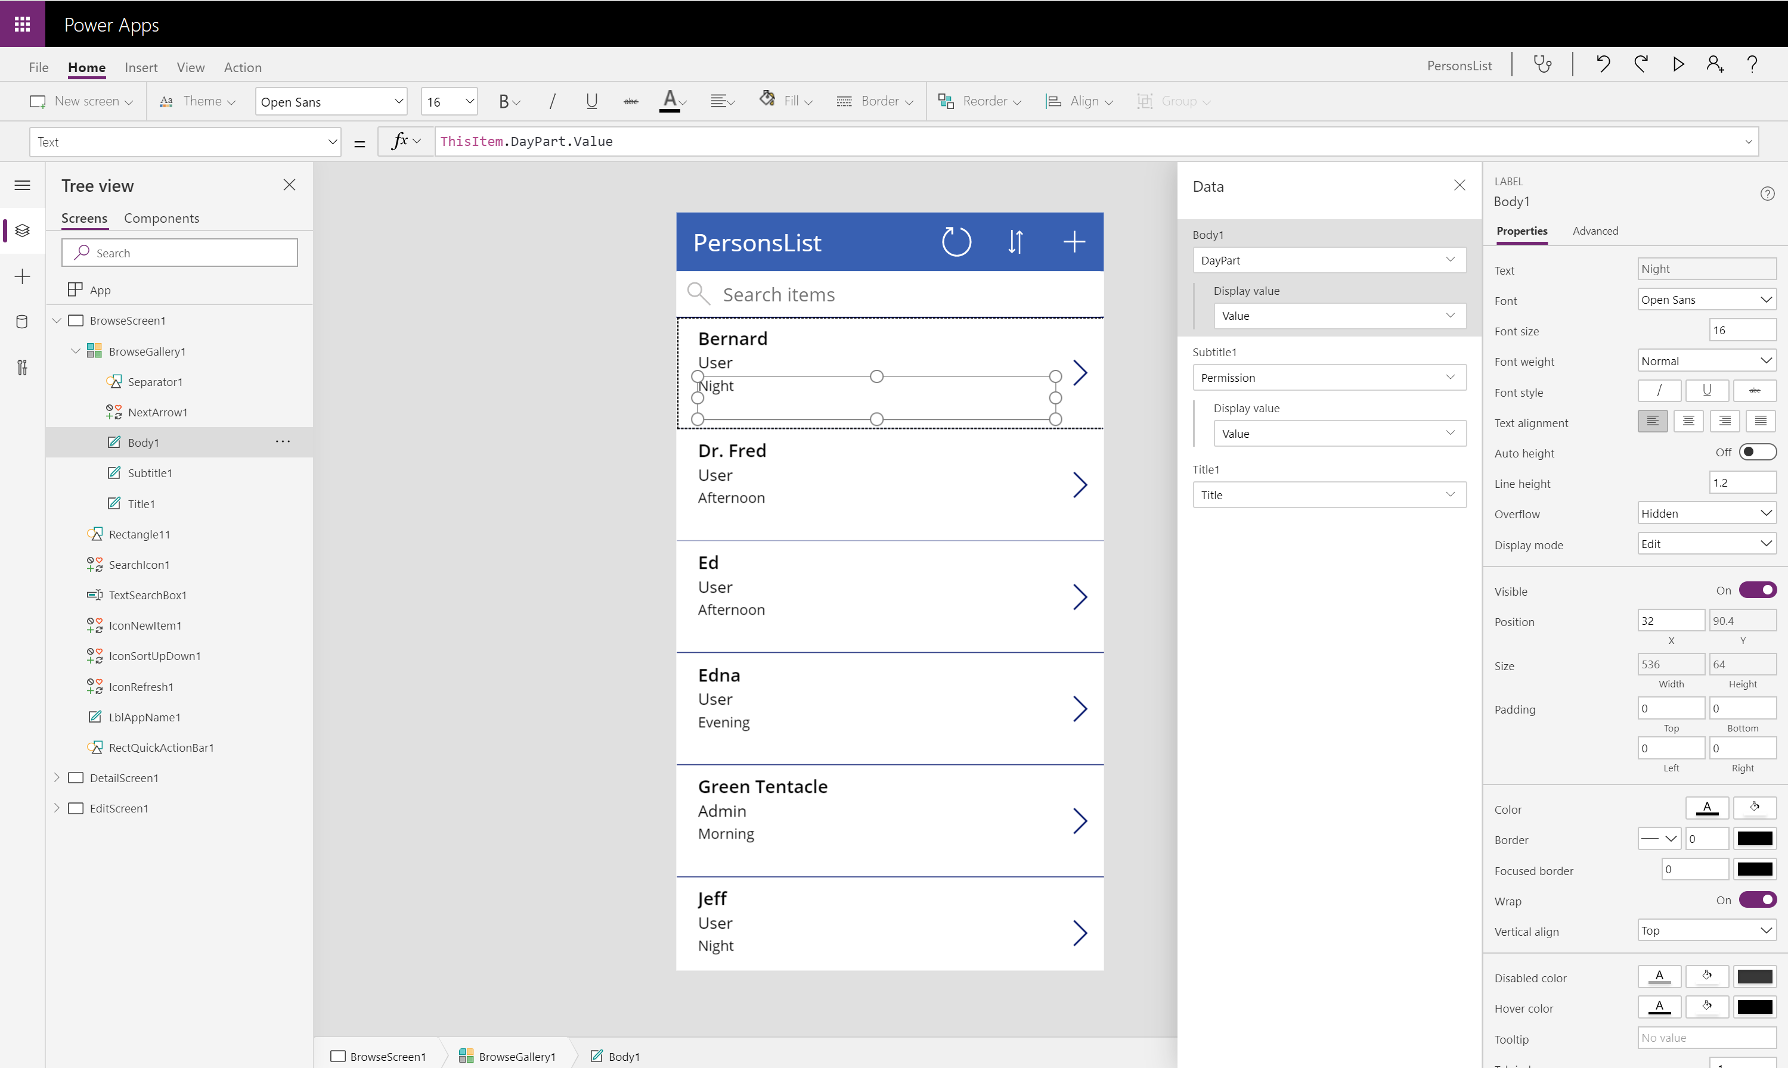
Power Apps Studio
Build business logic into your apps
Craft forms and screens
Power your app through data
Take advantage of device capabilities
Notes:
Discuss:
To access go to: https://make.powerapps.com
Craft forms and screens in a visual designer that helps you see exactly what you’ll get
Take advantage of device capabilities like cameras, GPS, and pen controls
Build business logic into your apps with an Excel-inspired expression language
Connect multiple existing data sources or create your own data to power your app
Mention:
Building useful line-of-business apps without needing to write code is, some of the key highlights through the Power Apps Studio :
A visual designer with a familiar user experience that enable you to build the screens you need to power your App.
You can build validation rules and business logic right into your screen using an Excel-function inspired expression language.
Take advance of the devoice specific sensor capabilities like cameras, GPS and Pen Controls to improve context awareness of the app and build even more powerful apps

Slide 28
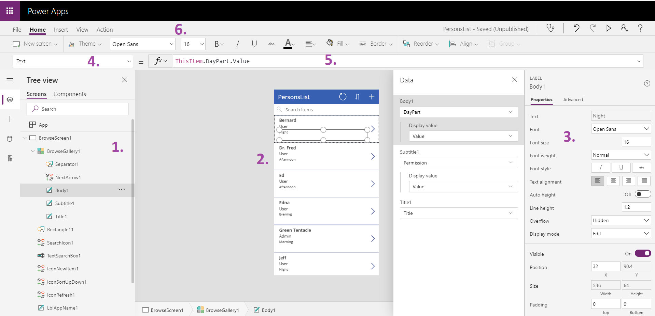
Power Apps Studio components
Notes:
Left hand navigation
Content pane
Right hand pane (options, data sources, etc.)
Dropdown list of properties
Formula bar for selected property
Ribbon
For more information on Power Apps Studio introduction, see: https://powerapps.microsoft.com/en-us/guided-learning/learning-powerapps-parts/

Slide 29
Power Apps Studio
Navigate to Power Apps Maker Portal
Deploy a template app
Explore app in Power Apps Studio

Slide 30
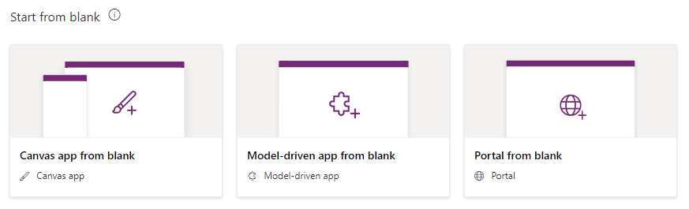
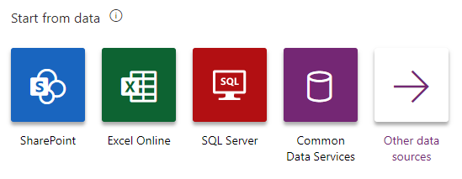
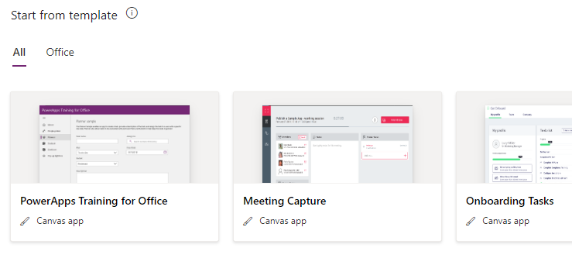
Creating an App
3 options for creating new apps:
Start from scratch (create from blank)
Start from data
Start from a template
Notes:
Create an app from template uses predesigned templates to get the app creator started building an application.
Create an app from data allows the app creator to connect to a predefined set of connectors (SharePoint, SQL Server, Oracle, Salesforce, Excel files on multiple cloud services, and more). At the time of writing only phone layouts can be used for
Create an app from scratch allows the app creator to design and connect to data as they see fit.
For more information on Create an app from a template, see: https://powerapps.microsoft.com/en-us/tutorials/get-started-test-drive/
For more information on Create an app from data, see: https://powerapps.microsoft.com/en-us/guided-learning/learning-create-first-app-powerapps/
For more information on Create an app from scratch, see: https://powerapps.microsoft.com/en-us/tutorials/get-started-create-from-blank/

Slide 31
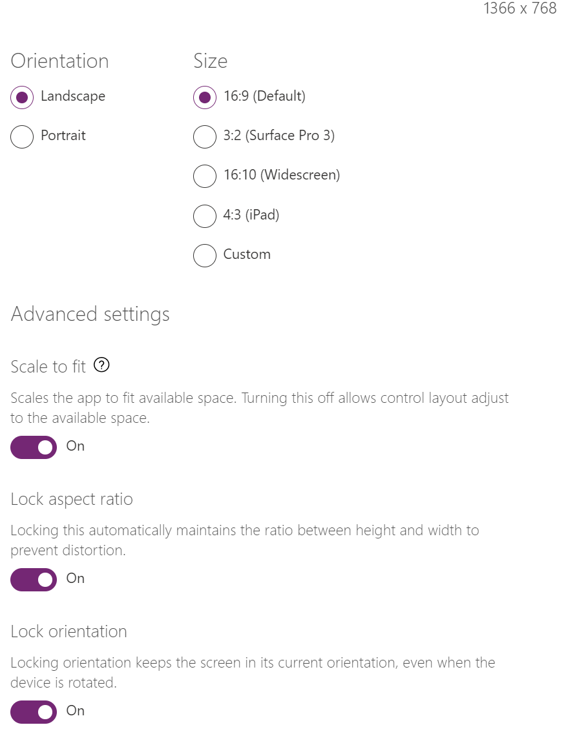
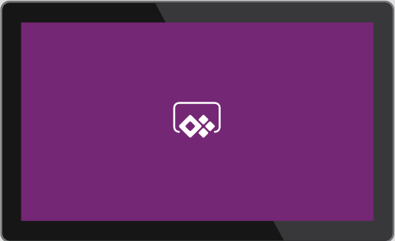
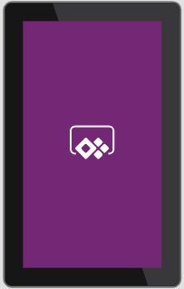
Layout options
Screen size + Orientation
Phone
Tablet
Notes:
Discuss:
Power Apps assumes mobile-first development, and as such, asks you to choose between an app optimized for phone or tablet screen size, and then orientation.
Once you make this choice, you cannot go back and change it, so it is a very important first decision. It is recommended to start with a phone layout, as the images, fonts, and UI controls will scale up when viewed on a tablet and look acceptable. If you start with Tablet, and then view on a phone, fonts and UI elements will shrink proportionately on the phone and may be too small to read effectively.
You can also choose the orientation of the app, and whether the app is locked to that orientation and aspect ratio.
Apps can adjust UI controls and elements to changing orientations by using formulas based on the ActiveScreen.Width or ActiveScreen.Height calculations.

Slide 32
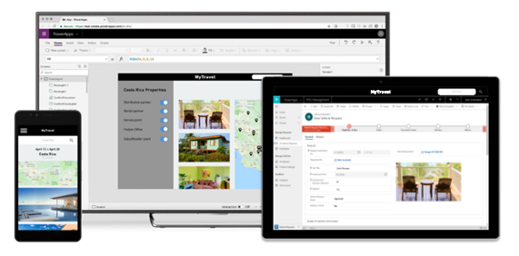
Power Apps is responsive
Notes:
Mention
Minimal effort to configure
Uses controls to maintain the desired experience
Discuss further in Module 4
Discuss
Creating a responsive layout means controls can respond to different devices or window sizes, making various experiences feel more natural.
Responsiveness allows different elements of the app to specify how they:
Stretch or resize with the screen size changes.
Maintain or change positions with the screen size changes.

Slide 33
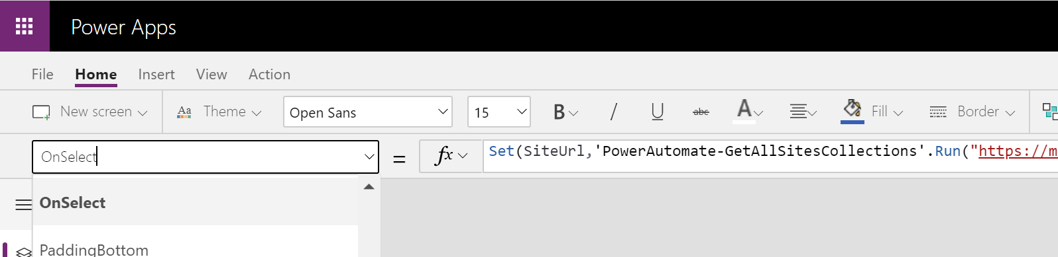
The formula bar
Choose the control/screen property
Control it with formulas
Notes:
This example shows us the properties for a control or screen in the dropdown on the left. On the right, we can see the associated formula bar for that property. In this example, we’ve placed a Navigate() formula for the OnSelect event/property of a Button control, telling it to navigate to the “Planners” screen.

Slide 34
SharePoint List as data repository
Containers for storing content within a SharePoint site
Lists organize content in the form of items (with or without attachments)
Libraries organize content in the form of documents or files
Notes:
Introduction to lists - SharePoint (microsoft.com)

Slide 35
Build a canvas app from blank
Objectives
In this lab, you will be able to:
• Sign into the Admin center
• Configure trial Power Apps per user (previously Plan 2)
Create Power App canvas app from blank
• Create SharePoint site and list
Scenario
The organization needs to replace legacy apps and has decided to onboard Power Apps as a platform. We will be learning how to create those apps as Citizen Developers.
Notes:
See lab file M1_PowerApps_PowerUser_Prereq.docx and complete all tasks for Exercise 3 and 4

Slide 36
1. Which layouts can you choose from?
A. Phone or Tablet
2. Name 3 ways of creating new apps?
A. Start from scratch (create from blank)
Start from data
Start from a template

Slide 37
Overview of Power Apps
Dataverse for Teams and PVA Overview
Administration overview
Fundamentals

